Slide 1

ML PROJECT
Het amin (143)
Moksha bhandari (146)

Slide 2
Mobile Price Prediction
LIBRARIES USED:
import pandas as pd
import numpy as np
import matplotlib.pyplot as plt
import seaborn as sns
from sklearn import metrics
from sklearn.model_selection import train_test_split
from sklearn.ensemble import RandomForestClassifier
from sklearn.tree import DecisionTreeClassifier
from sklearn.model_selection import GridSearchCV

Slide 3
Continue
from sklearn.metrics import accuracy_score, confusion_matrix,
classification_report
from sklearn.svm import SVC
from sklearn.datasets import make_classification
from sklearn import preprocessing
from sklearn.model_selection import KFold
from sklearn.model_selection import cross_val_score
from sklearn.preprocessing import StandardScaler

Slide 4
Importing Dataset
The read_csv function is primarily used to read data from a CSV (Comma-Separated Values) file into a Pandas DataFrame. It offers a flexible way to handle various CSV formats and provides several parameters to customize the reading process.
SYNTAX: data = pd.read_csv('CellPhone_train.csv’)
A Pandas DataFrame is a 2D labeled data structure with columns that can hold different data types. It's used for data analysis, manipulation, and visualization.
SYNTAX: df=pd.DataFrame(data)

Slide 5
Problem Definition
TITLE: Identifying Key Insights from Cellphone Data
OBJECTIVE: Analyze smartphone specifications to understand price trends, performance capabilities, and market positioning..
GOAL: Extract insights from smartphone data to guide purchasing decisions and trend forecasting.

Slide 6
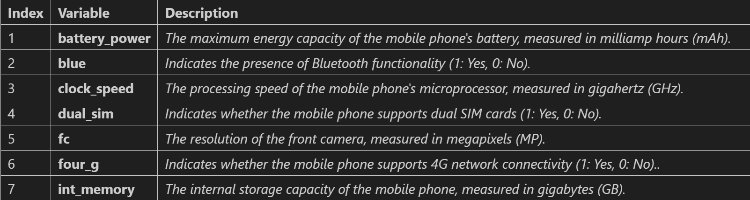
Dataset Description
Overview of SmartPhone Dataset
Total Entries: 2000 smartphones
Columns: 21 key features

Slide 7
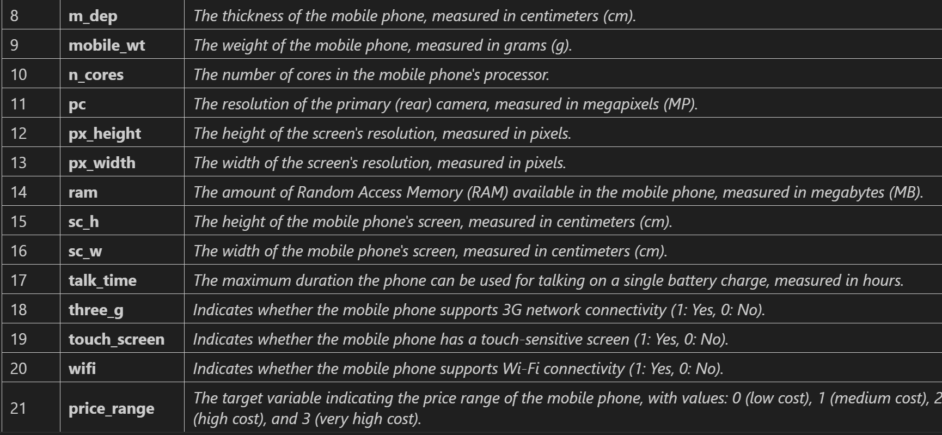
Dataset Description

Slide 8
Data Preprocessing & Cleaning Steps
Data cleaning and preprocessing are crucial steps in any data analysis or machine learning pipeline. They involve identifying and correcting errors, inconsistencies, and missing values in the data to ensure its quality and reliability.
Key Steps in Data Cleaning and Preprocessing:
Handling Missing Values:
Deletion: Removing rows or columns with missing values.
Imputation: Filling missing values with estimated values (e.g., mean, median, mode, or more sophisticated techniques like interpolation).
Outlier Detection and Handling:
Statistical Methods: Identifying outliers using techniques like Z-scores or IQR.
Visualization: Using box plots or scatter plots to visually identify outliers.
Handling: Removing, capping, or imputing outliers based on the specific context.

Slide 9
Continue
Data Formatting and Normalization:
Formatting: Ensuring data is in the correct format (e.g., converting text to numerical values).
Normalization: Scaling numerical features to a common range (e.g., min-max scaling, standardization).
Feature Engineering:
Creating New Features: Deriving new features from existing ones (e.g., combining features, calculating ratios).
Feature Selection: Identifying the most relevant features for the analysis.
Data Integration:
Merging Datasets: Combining multiple datasets based on common keys.
Resolving Inconsistencies: Addressing discrepancies in data formats, units, or definitions.

Slide 10
Model training without hyperparameter
X = df.drop('price_range', axis=1): This line removes the 'price_range' column from the dataframe df. It's assumed this column contains the target variable (what you want to predict), and gets separated into its own variable y in the next step.
y = df['price_range']: This assigns the 'price_range' column to the variable y. This variable represents the labels we want the models to predict.
scaler = StandardScaler(): This line creates an instance of the StandardScaler class from the scikit-learn library. Standardization is a common preprocessing technique that scales features to have a mean of 0 and a standard deviation of 1. This can improve the performance of some machine learning models.
X_scaled = scaler.fit_transform(X): This line fits the scaler to the data X (all features except the target variable) and transforms the data using the fitted scaler. Standardization is done by subtracting the mean and dividing by the standard deviation for each feature.

Slide 11
Spliting into training and testing
Splitting Data into Training and Testing Sets:
X_train, X_test, y_train, y_test = train_test_split(X_scaled, y, test_size=0.2, random_state=0): This line uses the train_test_split function from scikit-learn to split the data into training and testing sets.
X_scaled and y are the features and target variables after scaling.
test_size=0.2 specifies that 20% of the data will be used for testing, and the remaining 80% will be used for training the models.
random_state=0 sets a random seed for reproducibility. This ensures that the split is always the same when you run the code again.

Slide 12
Training and Evaluating Models
Decision Tree (DT):
dt_model = DecisionTreeClassifier(random_state=0): This line creates an instance of the DecisionTreeClassifier class. T
dt_model.fit(X_train, y_train): This line trains the decision tree model on the training data X_train and y_train. The model learns decision rules based on the features to predict the target variable.
dt_pred = dt_model.predict(X_test): This line uses the trained decision tree model to make predictions on the testing data X_test.
print("Decision Tree Accuracy:", accuracy_score(y_test, dt_pred)): This line calculates the accuracy of the decision tree model on the testing data. Accuracy is the proportion of predictions that are correct.
print("Decision Tree Classification Report:\n", classification_report(y_test, dt_pred)): This line prints a classification report that provides information about the model's performance such as precision, recall, and F1-score for each class in the target variable.
Random Forest (RF):
The process for Random Forest follows a similar structure as the Decision Tree. Support Vector Machine (SVM):
The process for SVM is similar as well. Here, SVM finds a hyperplane that best separates the data points belonging to different classes.

Slide 13
Model Training with Hyperparameter Tuning
Data Preprocessing:
Drop 'price_range': The code removes the target variable 'price_range' from the feature set (X). This is because the model needs to predict this variable based on the remaining features.
StandardScaler: It applies standard scaling to the features in X. This helps normalize the data by centering it around a mean of 0 and scaling it to a standard deviation of 1. This can improve the performance of some machine learning algorithms.
Train-Test Split:
train_test_split: The code splits the scaled data (X_scaled) and target variable (y) into training and testing sets. The training set (80%) is used to train the models, and the testing set (20%) is used to evaluate their performance on unseen data.

Slide 14
Machine Learning Models
Decision Tree (DT):
It's a tree-like structure where each internal node represents a feature and each branch represents a decision based on the feature value. The model recursively splits the data based on these decisions until it reaches leaves that represent the predicted categories (price ranges).
GridSearchCV: This performs a grid search to find the best hyperparameter combination for the Decision Tree model. It tries different values for max_depth (maximum tree depth) and min_samples_split (minimum number of samples required to split a node) and selects the combination that yields the best performance on the training data.
Evaluation: After finding the best parameters, the code uses the trained model (dt_best) to make predictions on the testing data. It then calculates the accuracy score and classification report to evaluate the model's performance.

Slide 15
Continue
2. Random Forest (RF):
It's an ensemble learning method that combines predictions from multiple Decision Trees. Each tree is trained on a random subset of features and data points, reducing the risk of overfitting.
GridSearchCV: Similar to DT, it finds the best hyperparameters for the Random Forest model, trying different combinations of n_estimators (number of trees), max_depth, and min_samples_split.
Evaluation: After finding the best parameters, the code uses the trained model (rf_best) to make predictions and calculates the accuracy and classification report on the testing set.

Slide 16
Continue
3. Support Vector Machine (SVM):
It aims to find a hyperplane (decision boundary) that best separates data points of different classes in high-dimensional space. This hyperplane maximizes the margin between the classes.
GridSearchCV: Similar to the other models, it performs a grid search to find the best hyperparameters for the SVM model. It tries different combinations of C (regularization parameter), kernel (function used for non-linear data), and gamma (parameter controlling the influence of data points).
Evaluation: After finding the best parameters, the code uses the trained model (svm_best) to make predictions and calculates the accuracy and classification report on the testing set.

Slide 17
Summary of Applied Models
Techniques Used:
DECISION TREE
RANDOM FOREST
SVM

Slide 18
Results
The project aims to predict the price range of mobile phones based on various features.
Data Preprocessing:
Data is cleaned and preprocessed to handle missing values and normalize features.
Model Selection and Training:
Three machine learning models are used: Decision Tree, Random Forest, and Support Vector Machine.
Hyperparameter tuning is performed using Grid Search to optimize the performance of each model.
Models are trained on the preprocessed data.
Model Evaluation:
The trained models are evaluated on a held-out test set using metrics like accuracy and classification report.
Model Comparison:
The accuracies of the three models are compared to identify the best-performing model.

Slide 19
CONCLUSION
The price_range variable in the dataset is a categorical indicating the price category of the mobile phones.
These likely represent discrete price brackets rather than the actual price. For instance:
0- might represent low-cost phones,
1- mid-range phones,
2- upper mid-range phones, and
3- high-end phones.
Since it is categorical, this variable does not require scaling like continuous variables; it serves as the target label for classification.
The goal is to build a reliable model that can accurately predict the price range of a mobile phone based on its features, aiding in decision-making and market analysis.

Slide 20


